Slide 1
Research Team
Team Leader
Dr. A.K. EnamulHaque
Research Coordinator
Estiaque Bari
Research Team
Eashan Ahmed (Training & Questionnaire Development)
Noman H Chowdhury (Questionnaire Development)
Kazi Nazmul Huda (Field Coordination)
Mohammed Zakir Hossain Khan (Technical support)
Zahidul Naim Zakaria (Technical Editing)

Slide 2
Bangladesh’s Garment Industry
5600 Firms under BGMEA
4.5 million workers
80% of export earnings of Bangladesh
20 Billion $ exports
2nd Largest Exporter in the World

Slide 3
Research Objectives
To develop a comprehensive picture of the workforce of the industry, their lives and the lives of their families
Specific objectives were understanding the impact of the sector in
  poverty reduction and improvement in the standard of living
  health and education of the workers and their family members
  women empowerment in the families of the workers

Slide 4
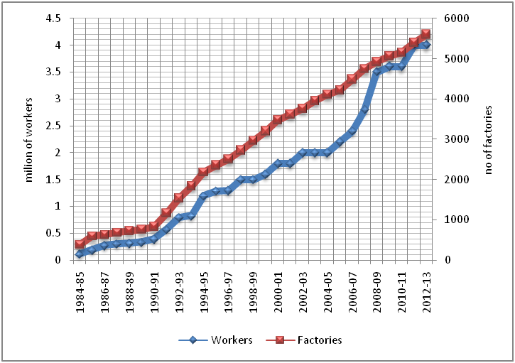
Macro information on the Sector

Slide 5
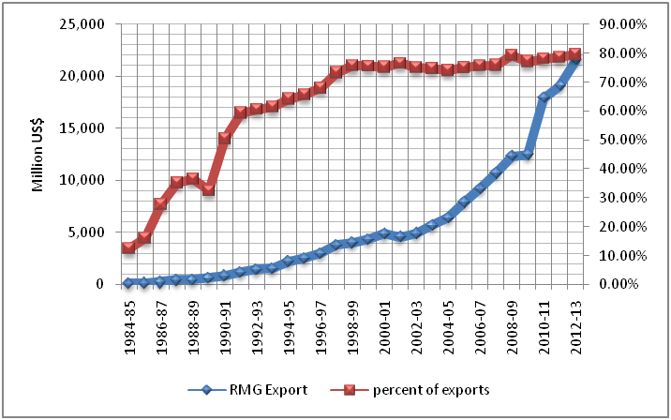
RMG Exports

Slide 6
Sampling
Type of industry | Dhaka | Chittagong | Total
Knitwear factories | 39 | 9 | 48
Sweater factories | 16 | 6 | 22
Woven factories | 77 | 8 | 85
Others factories | 12 | 6 | 18
Total | 144 | 29 | 173
A total of 686 factories were selected randomly using a computerized random table (574 from Dhaka and 112 from Chittagong) in order to conduct this survey.

Slide 7
# workers Surveyed
Type of Industry | Grade 1 | Grade 2 | Grade 3 | Grade 4 | Grade 5 | Grade 6 | Grade 7 | Total
Knitwear factories | 4 | 8 | 71 | 74 | 68 | 51 | 60 | 336
Woven factories | 2 | 6 | 27 | 29 | 33 | 26 | 31 | 154
Sweater factories | 6 | 12 | 111 | 135 | 109 | 86 | 129 | 588
Others factories | 1 | 0 | 27 | 26 | 27 | 21 | 24 | 126
Total | 13 | 26 | 236 | 264 | 237 | 184 | 244 | 1,204

Slide 8
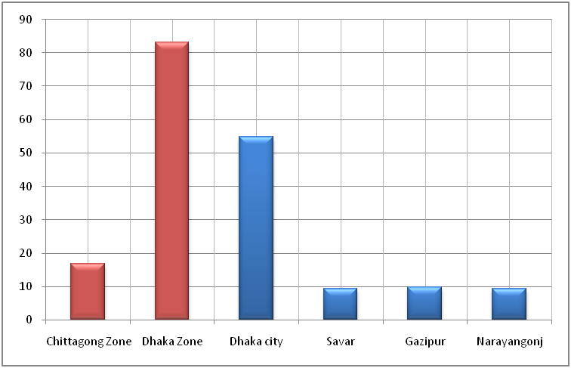
Geographic Distribution

Slide 9
Size of Factories and Male-Female Ratio
Industry Type | Male | Female | Total Workers
Knitwear factories | 43% | 57% | 1106
Sweater factories | 49% | 51% | 749
Woven factories | 30% | 70% | 990
Others factories | 30% | 70% | 577
All factories | 36% | 64% | 947
Our estimate shows that nearly 4.0 million workers are connected to the garment industry directly, of which 1.4 million are male and 2.6 million are female.

Slide 10
Size of workforce
Industry Type | Male | Female | All
Knitwear factories | 455,000 | 620,000 | 1,065,000
Sweater factories | 253,000 | 278,000 | 519,000
Woven factories | 572,000 | 1,355,000 | 1,920,000
Others factories | 109,000 | 254,000 | 364,000
All factories | 1,435,000 | 2,591,000 | 4,001,000

Slide 11
Educational background

Slide 12
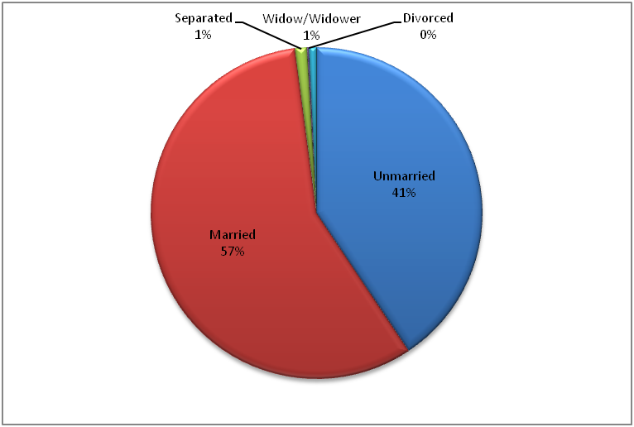
Marital Status

Slide 13
Age and Workers by Grade
 | Grades of pay | Percent of worker |  | Average Age
 |  | Male | Female | Male | Female
Skilled | G -1 | 0.91 | 0.08 | 32.09 | 30.00
 | G-2 | 1.74 | 0.25 | 30.38 | 29.67
 | G-3 | 9.05 | 10.30 | 26.67 | 26.01
Semi-skilled | G-4 | 8.80 | 13.12 | 25.43 | 24.37
 | G-5 | 6.64 | 12.62 | 23.90 | 24.19
Unskilled | G-6 | 3.90 | 10.96 | 23.19 | 23.19
 | G-7 | 8.31 | 11.46 | 21.57 | 23.14
All workers |  | 40.08 | 59.92 | 24.83 | 24.16

Slide 14
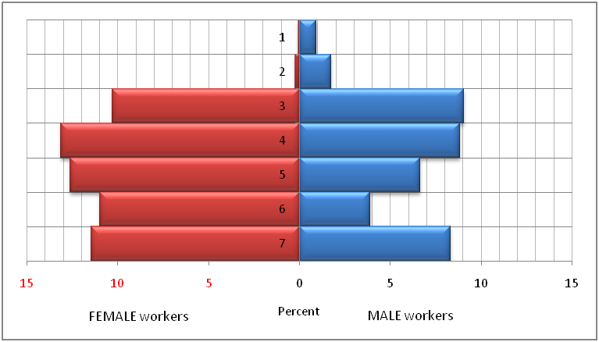
Distribution by Gender

Slide 15
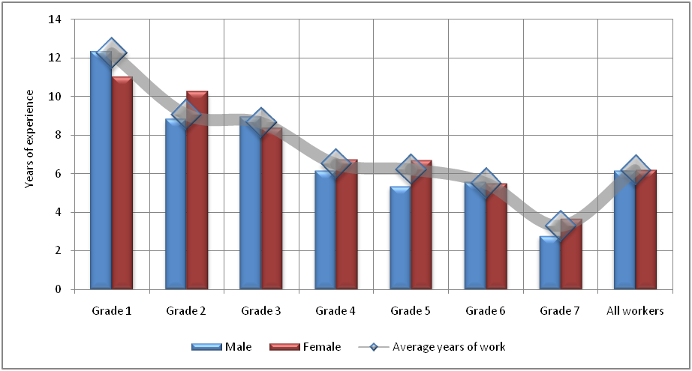
Years at work by grade

Slide 16
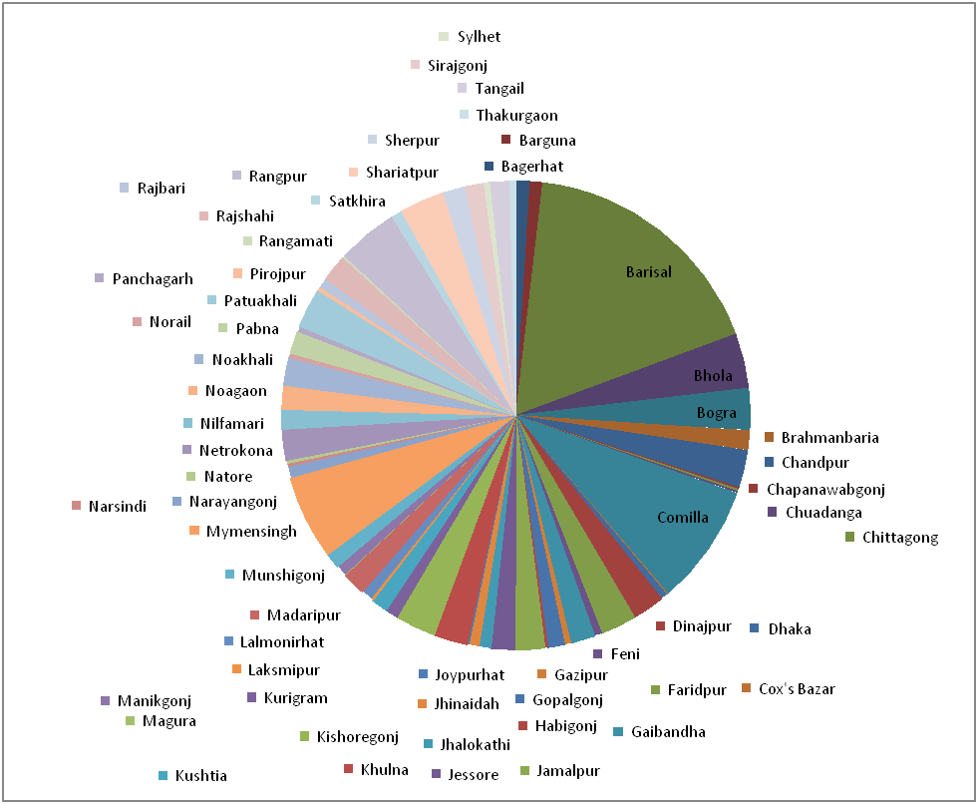
Home districts of workers

Slide 17
Work environment perception by factories
Items | Average | SD
1 | 2 | 3
Acceptable ambient environment | 99.5% | 4.6%
Adequate lighting | 99.7% | 2.1%
Existence of emergency exits | 98.0% | 11.0%
Locked emergency exits | 8.2% | 19.6%
Barriers at the emergency exit | 17.3% | 30.8%
Training of emergency exits | 94.0% | 16.6%
Existence of fire extinguishers | 99.1% | 7.9%
Training to use fire extinguisher | 92.0% | 20.0%
Supply of drinking water | 97.2% | 14.4%
Food cafeteria at the factory | 86.3% | 30.9%
Use of cafeteria by workers | 51.3% | 35.0%
Existence of childcare facilities | 81.2% | 33.5%
Use of childcare facilities by working parents | 14.0% | 33.7%

Slide 18
Salary payment
Workplace Facility | percent
Regularity in salary | 93.07
Usually receive Eid bonus | 97.67
Percent received the last Eid bonus | 92.55

Slide 19
Non-monetary benefits to workers
 | Male | Female | Total
Breaks at work
1 time | 93.23 | 93.39 | 93.33
2 times | 6.77 | 5.77 | 6.17
3 times | 0 | 0.84 | 0.51
Nature of work
Standing | 26.3 | 16.69 | 20.53
Sitting | 49.48 | 72.74 | 63.44
Standing / sitting | 24.22 | 10.57 | 16.03
Use of machines during work | 71.34 | 71.73 | 71.57
Allowed to take leave for personal reasons | 98.05 | 98.29 | 98.20
No of days took leave last year | 5.45 | 5.83 | 5.69
Standard deviation | 4.99 | 4.63 | 4.77
Maximum | 63 | 31 | 63
percent took leave | 72% | 77% | 75%
Conditions of leave (percent)
Full salary paid | 89.62 | 90.63 | 90.24

Slide 20
Contd …
 | Male | Female | All
Partial salary paid | 9.29 | 7.5 | 8.18
without salary | 1.09 | 1.87 | 1.57
Maternity Leave (in days) |  | 100.85
minimum days |  | 30
maximum days |  | 262
rejoined the work (percent) |  | 92.31
Workplace harassment (percent) |  | 2.08
received help from supervisor/co-worker |  | 66.67
Distance from home to work
in km | 1.65 | 1.55 | 1.59
in walking time | 18.20 | 17.06 | 17.51

Slide 21
Household profile of workers
Household | Percent | Mean
Household Size | 100.0 | 4.05
Male Members | 97.1 | 2.00
Female Members | 98.0 | 2.16
Female only household | 2.9 | 2.66
Male only household | 2.0 | 2.29
Earning member | 100.0 | 2.19
Male | 92.4 | 1.41
Female | 72.8 | 1.22

Slide 22
Living with family?
Family status | percent | percent
Living with family | 74% | 74%
Living without Family | 22%
Family living in another city |  | 1%
Family living in village |  | 21%
Workers without family (orphans) | 4% | 4%
Total | 100% | 100%

Slide 23
With whom they live in? (when not living with family/parents)
Who are you living with? | Percent | Percent of total
Relatives | 19.4 | 5.07
Friends | 1.3 | 0.33
Rented house | 19.4 | 5.07
Hostel | 52.4 | 13.70
Others | 7.6 | 1.99
Total | 100.0 | 26.16

Slide 24
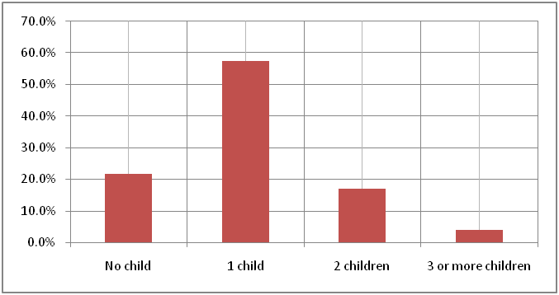
# of children of married workers

Slide 25
Worker as family head
Head of the Household | percent
Male worker | 40.0
Female worker | 12.8
All worker | 23.7

Slide 26
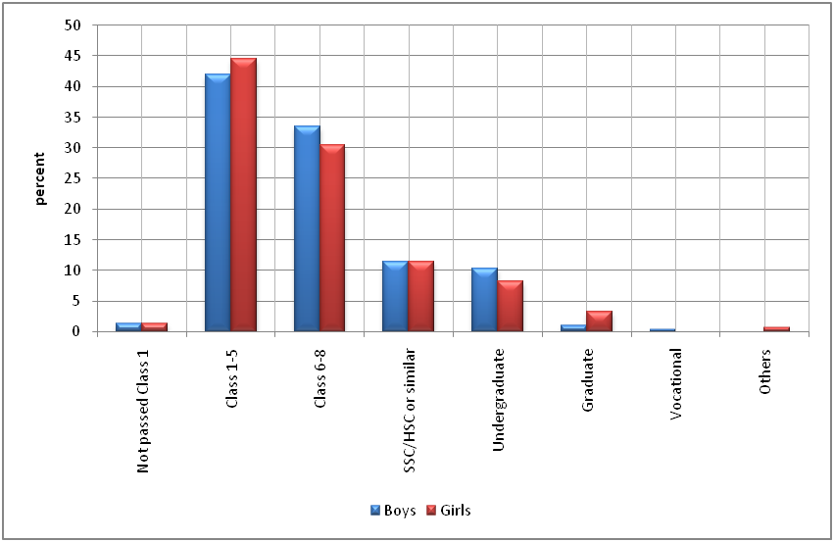
Children’s/Ward’s education
[unskilled workers’ families]

Slide 27
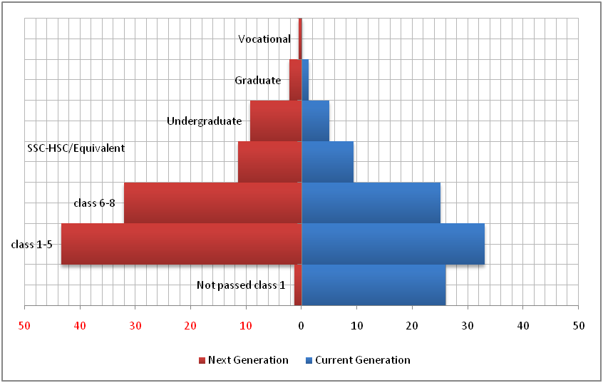
Education by generations

Slide 28
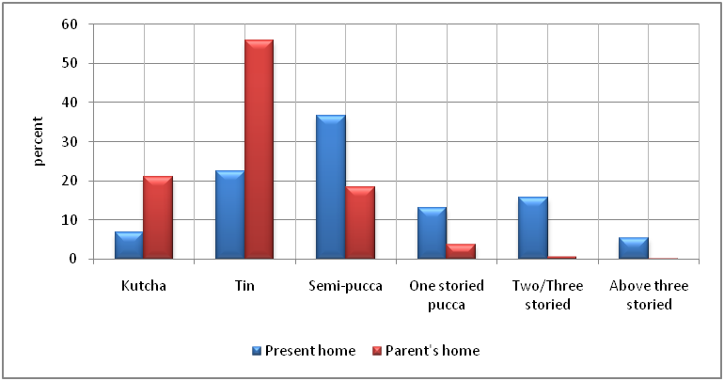
Changes in housing standard

Slide 29
Monthly family income

Slide 30
Monthly income [hh income vs worker’s income]
 | Grade | Monthly income of the Workers | Monthly Household income* | percent of workers
Skilled workers | Grade 1 | 19,044 | 19,923 | 1%
 | Grade 2 | 12,687 | 16,308 | 2%
 | Grade 3 | 7,729 | 16,364 | 20%
Semi-skilled workers | Grade 4 | 6,581 | 15,424 | 22%
 | Grade 5 | 6,494 | 15,426 | 20%
Unskilled workers | Grade 6 | 6,329 | 15,685 | 15%
 | Grade 7 | 5,625 | 15,500 | 20%
All workers | All grades | 6,820 | 15,719 | 100%

Slide 31
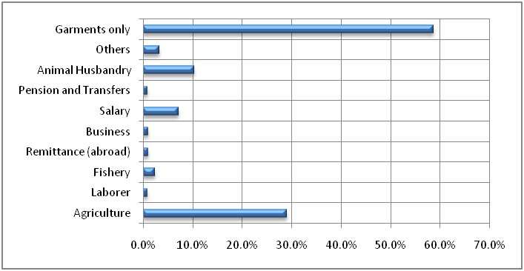
Sources of family income

Slide 32
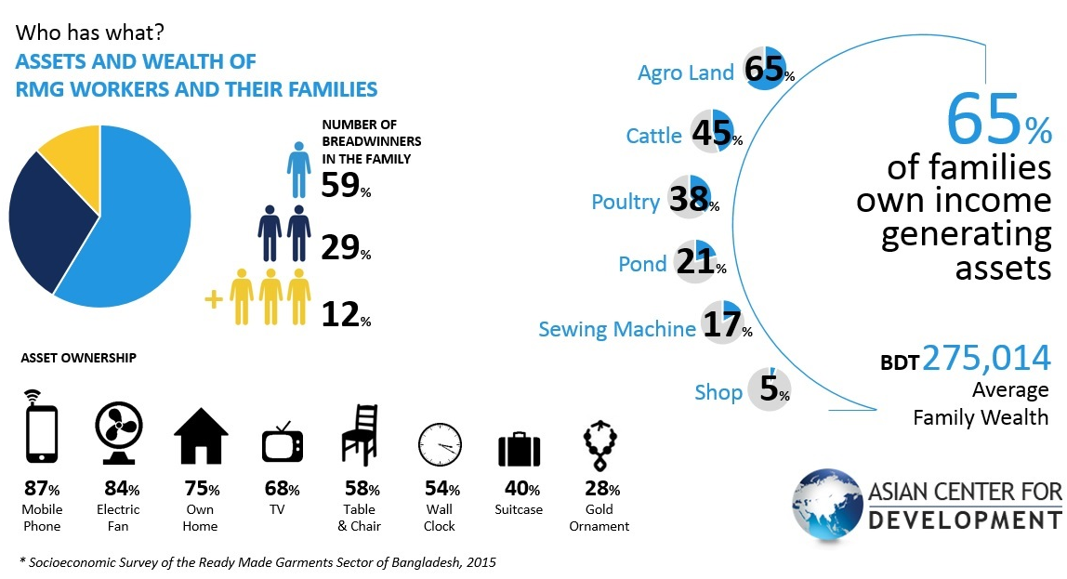
Family income earners and wealth

Slide 33
Family expenditure (monthly)
Average Family Expenses per month | per household expenditure | per person expenditure | percent of monthly expenditure | percent of household
BD Taka
Rent and Utilities | 3,409.64 | 861.02 | 30% | 93%
Food Cost | 4,782.18 | 1,207.62 | 42% | 80%
Clothing | 529.62 | 133.74 | 5% | 51%
Mobile | 316.58 | 79.94 | 3% | 80%
Education | 667.21 | 168.49 | 6% | 38%
Cosmetics | 299.03 | 75.51 | 3% | 64%
Health Cost | 604.37 | 152.62 | 5% | 49%
Travel to work | 229.94 | 229.94 | 2% | 44%
Remittance to home | 1,292.19 | 1,292.19* | 11% | 42%
Entertainment | 98.98 | 25.00 | 1% | 34%
Other expenditure | 2,478.91 | 625.99 | 22% | 100%
Total | 11,299.02 | 2,853.29

Slide 34
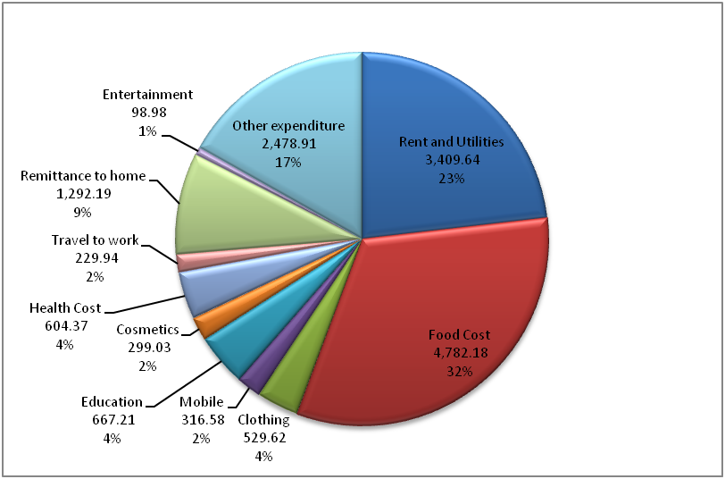
Distribution of expenditure

Slide 35
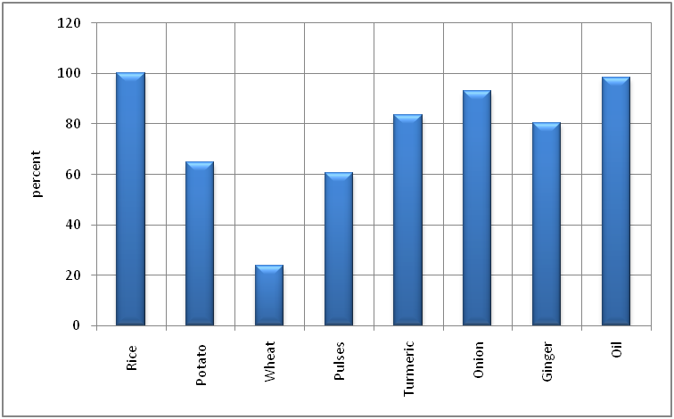
Daily food items

Slide 36
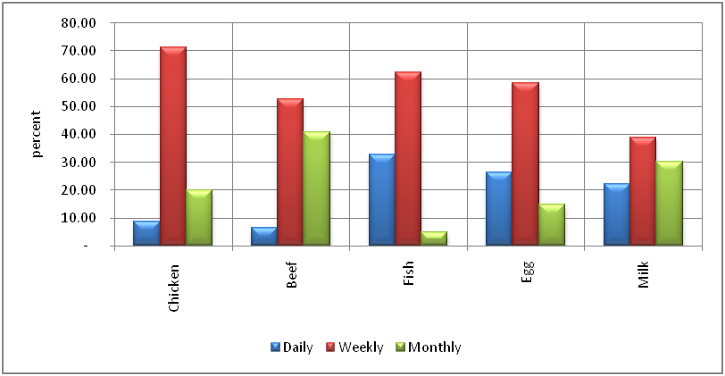
Protein

Slide 37
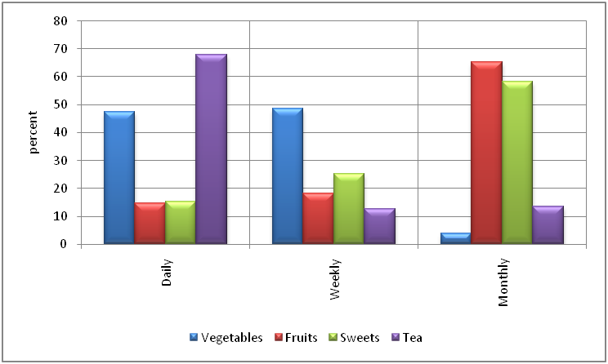
Fruits and others

Slide 38
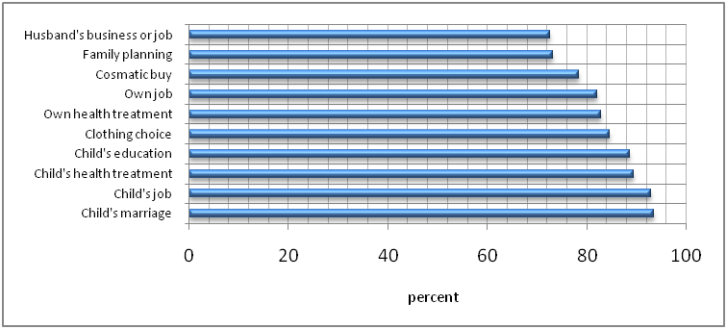
Top 10 ‘has my say’ for female workers

Slide 39
To 10 ‘Has partial say’

Slide 40
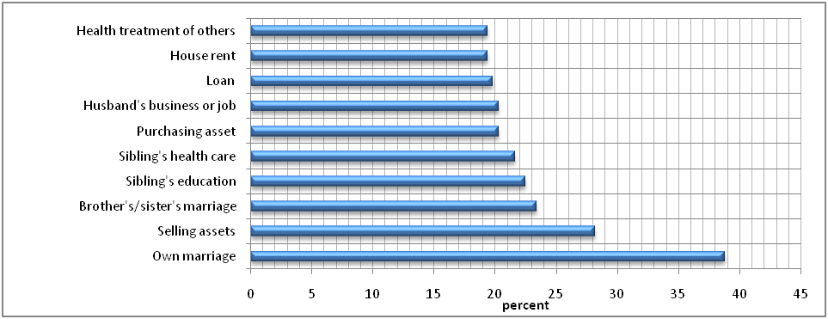
Not or rarely consulted decisions

Slide 41
Perception on empowerment
Perception issues | Percent | Percent
Self-reliance | 98.00
Importance in the family | 92.80
Travel to work alone | 59.66 | 59.66
Travel to work in a group | 40.34
Why?
Like travelling in groups |  | 21.72
Live in same place |  | 17.35
Afraid of travelling alone |  | 1.27
Total | 100.00 | 100.00

Slide 42
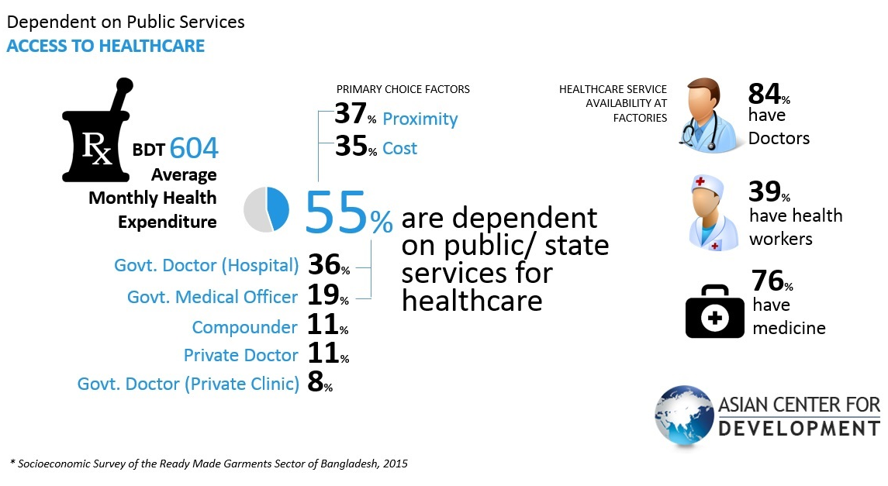
Health care services

Slide 43
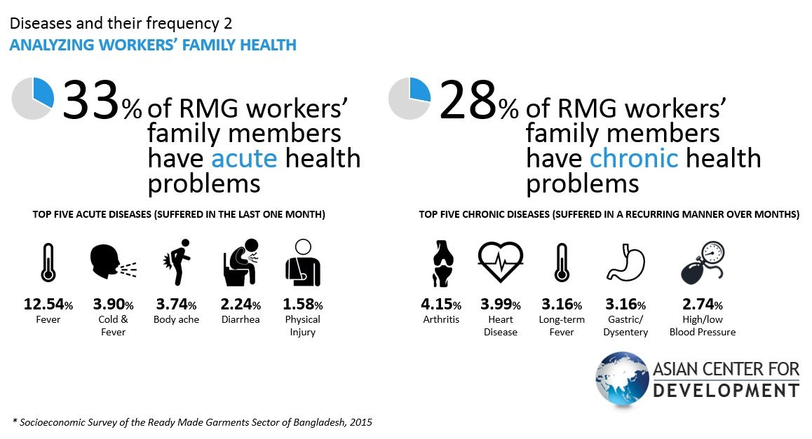
Health status

Slide 44
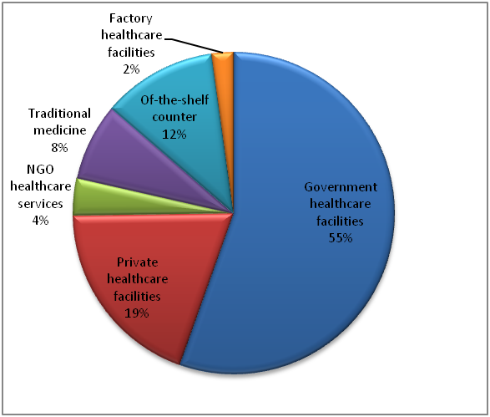
Health care facilities

Slide 45
Cost of treatment

Slide 46
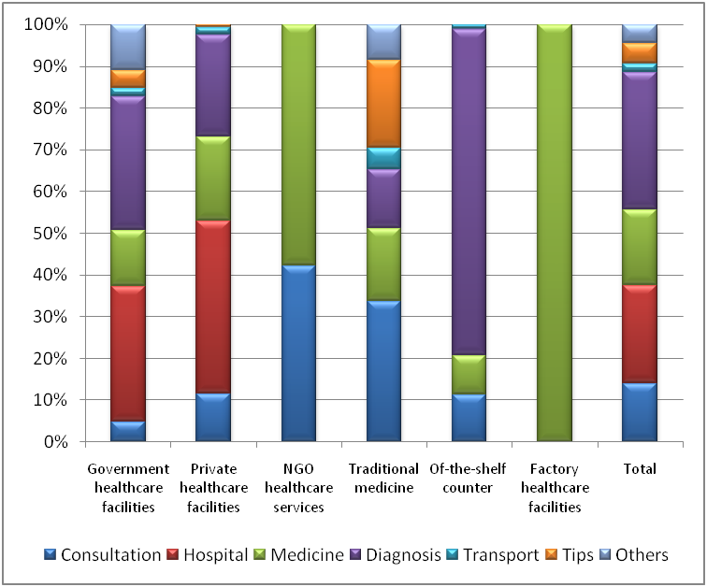
Distribution of treatment cost

Slide 47
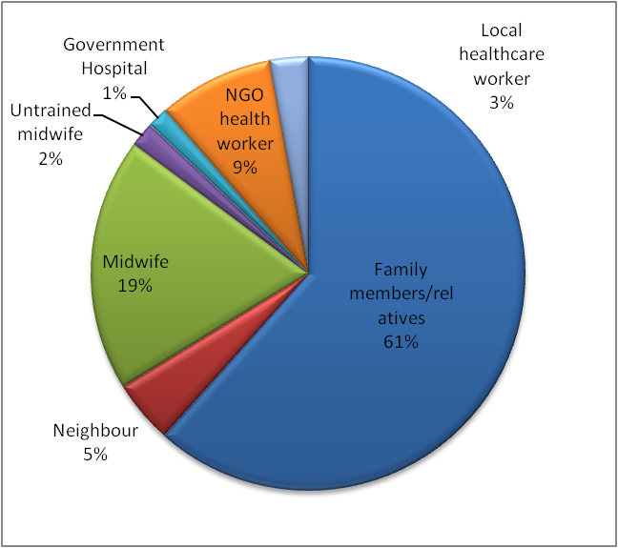
Delivery of child

Slide 48

Thank you

